Slide 1
State Variation in Cannabis Regulations Concerning Older Americans
Brian Kaskie PHD, Fadi Martinos MPH, Kameron Adams MHA
November 8 2023

Slide 2

Lifetime & current use among Older Americans

Slide 3
Existing Policy Scales: Blanchette et al., (2022)
Examples of policies used
Policy Score Objectives
Advertising restrictions
Cannabis Possession Limits
Clean air and smoke-free laws
Impaired-driving laws
Penalties for adults who possess cannabis for personal use
Physical retail availability restrictions
Product design restrictions and requirements
Excessive cannabis use in the general population
Cannabis use among youth
Cannabis use & impaired driving

Slide 4
Older Persons & State Policies: What matters most
Evidence from the Health Retirement Survey
Existing Studies
Hospice & End of Life Care
Chronic pain relief & Cannabis culture
Medical Cannabis & Palliative care
Cannabis use & Arthritis, cancer, and MS type of care
Cannabis use , Persons with Dementia & their Caregivers
Our team has did studies on the above.
Regional effect
Utilization for specific Medical Conditions
Add a bit more. People who used and people who did not use. People who lived in certain regions in the country used more cannabis.

Slide 5
Examine State Permissiveness in cannabis policies that pertain to older adults.
Research Objective:

Slide 6
Permissiveness
Accessibility
Legal Status
Care Giver Proxy
Accommodation
Qualifying conditions & Symptoms
Prescribing Provider
Home Cultivation
End of Life Care
Availability of Delivery Services
Institutional Care

Slide 7
Methodology
Sample
Data Sources
Years of Analysis
All 50 states
State Websites
Lexis+
Westlaw
1999-2023 (current effective codes)

Slide 8
Measures
Policy | Score
Legal Status
Low THC | 0.33
Medical | 0.66
Fully Legal | 1
Care Giver Proxy | 1
Home Cultivation | 1
Delivery Services | 1
Accessibility
Notes:
Assigned weights. 1/0. Weighted incase

Slide 9
Policy | Score
Qualifying Conditions | 1
Cancer | 0.125
Alzheimer's Disease | 0.125
Osteoarthritis | 0.125
Rheumatoid Arthritis | 0.125
Spinal-related illnesses | 0.125
Fibromyalgia | 0.125
Multiple Sclerosis | 0.125
Post Traumatic Stress Disorder | 0.125
Qualifying Symptoms | 1
Anxiety | 0.125
Cachexia | 0.125
Depression | 0.125
Stress | 0.125
Insomnia | 0.125
Spasticity | 0.125
Nausea | 0.125
Chronic Pain | 0.125
Provider Discretion | 1
End of Life Care | 1
Provider | 0.25-1
Long Term Facilities | 1
Accommodation

Slide 10
Results

Slide 11
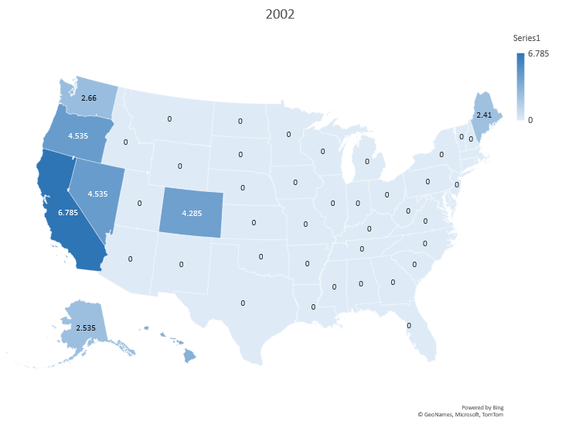
Accessibility & Accommodation
Notes:
Connecticut highest score.

Slide 12
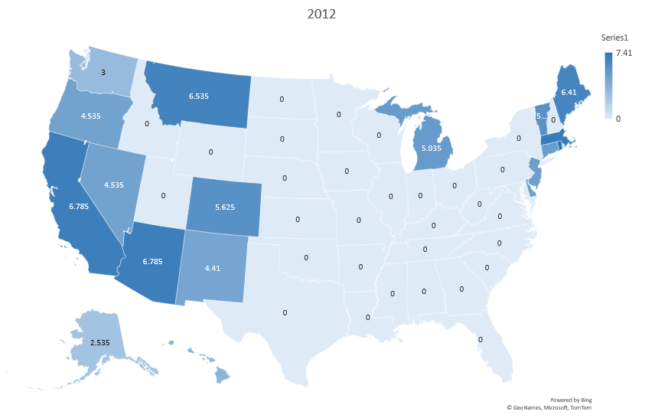
Accessibility & Accommodation

Slide 13
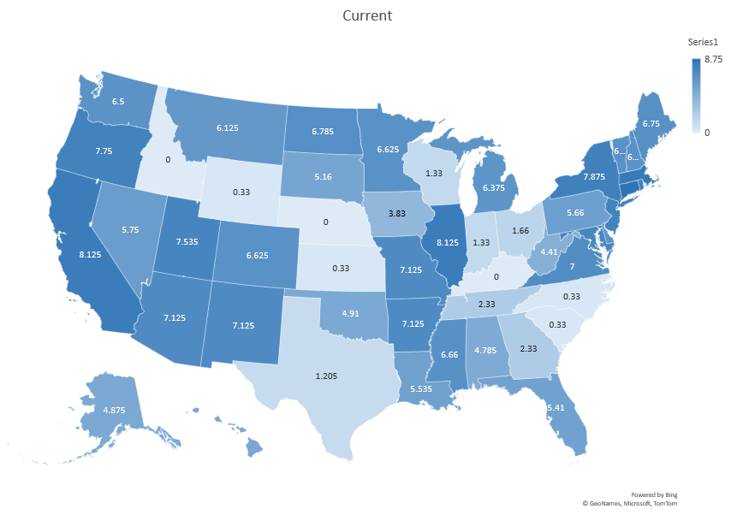
Accessibility & Accommodation

Slide 14
Permissiveness & Time
Alaska Old Program Stable over time and moderately Permissive | Washington Old Program Continuously increasing over time & Highly Permissive
Iowa New Program Stable over time and less permissive | Illinois New Program Continuously increasing over time & Highly Permissive

Slide 15
Our study
Existing studies (e.g. Blanchette et al., 2022)
Measures: policies pertaining to older adults
Results: Connecticut as most permissive state and Nebraska as least permissive.
Measures: policies pertaining to over consumption, impaired driving, and youth consumption
Results: Nevada as least restive state and Indiana as most restrictive.

Slide 16
Discussion

Slide 17
Summary of Findings
State Policies pertaining to older adults vary considerably.
These state policies have changed considerably over time.
We are identifying unique aspects of policies specific to older adults.

Slide 18
Next Steps
Efficacy Rating
Relationship with Market conditions
Relationship between policy and individual cannabis use
Inviting a group of panelists, specialized on aging to rate the policies considered.
Examine how market related factors such as supply of dispensaries and sales influence our results
Revisit the Health Retirement Survey and move from looking at regional effects to state specific effects.

Slide 19
Questions?
For further inquiries: fadi-martinos@uiowa.edu
brian-kaskie@uiowa.edu

