Slide 1

The Iowa Medical Cannabidiol Program: A Survey of Iowa Physicians
Kanika Arora, PhD
Brian Kaskie, PhD
Department of Health Management & Policy
College of Public Health
University of Iowa

Slide 2
Acknowledgements
Cannabis and Older Persons Study at the University of Iowa
Julie Bobitt (University of Illinois at Urbana-Champaign, College of Applies Health Sciences)
Gary Milavetz (University of Iowa, College of Pharmacy)
James Alton Croker (University of Iowa College of Public Health)
Emma Cole (University of Iowa College of Public Health)
Sara Qualls (University of Colorado Colorado Springs, Aging Center)
Hillary Lum (University of Colorado Anschutz School of Medicine)
Current and Past Funding:
Colorado Department of Public Health and Environment (CDPHE) Marijuana Public Health Research Pilot Grant
Illinois Department of Public Health
Retirement Research Foundation
California Alzheimer’s Disease Research Center – Rancho Los Amigos Clinic

Slide 3
Medical Cannabis Use and Older Persons
Clinicians report rapidly increasing rates of cannabis use among older adults
Based on national survey data from 2006-2013, Han et al. (2017) found:
  58% relative increase in past-year cannabis use for adults aged 50-64
  250% relative increase in past-year cannabis use for adults aged 65 years and older
Age-related health care needs are driving the increasing use of medical cannabis among persons over 50
Notes:
Prevalence of past-year marijuana use was 9.0% among adults aged 50–64 and 2.9% among adults aged ≥65. rates of cannabis use among middle and high school students have dropped or leveled-off (Johnston et al, 2015)
In light of emerging new knowledge about the potential benefits and harms of medical cannabis (National Academies of Sciences, Engineering and Medicine review), understanding current attitudes and beliefs of providers may provide insight into the ongoing challenges they face as states expand access to medical cannabis.
The present article reports the results of an online survey conducted among Iowa clinicians in April-May 2019. It assessed Iowa clinicians’ attitudes, knowledge, and practices as it relates to MC. It also assessed their participation in the IA cannabidiol program

Slide 4
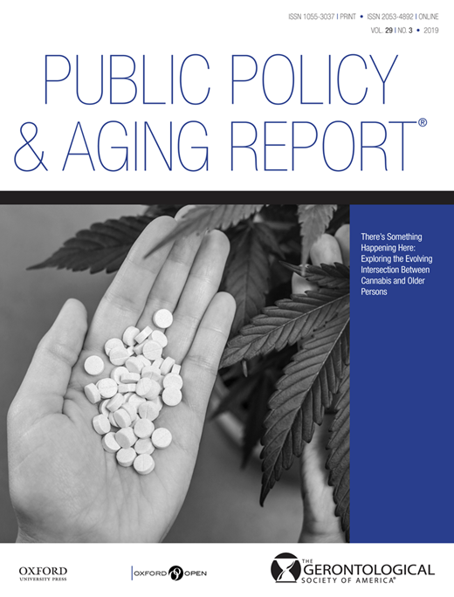
PEER-REVIEWED PUBLICATIONS
Kaskie B, Ayyagari P, Milavetz G, Shane D & Arora, K. The increasing use of cannabis among older Americans: A public health crisis or viable policy alternative? The Gerontologist. 57, 6, 1166-1172, 2017.
Arora K., Qualls S. Bobitt J, Lum H., Milavetz G., Croker J, & Kaskie B. Measuring attitudes towards medical and recreational cannabis among older adults in Colorado. The Gerontologist, DOI: 10.1093/geront/gnz054, 2019.
Bobitt, J, Qualls, S, Arora K, Croker J & Kaskie B. Emerging themes concerning the increasing use of cannabis among older adults. Drugs and Aging, 36, 7, 655-666. DOI: 10.1007/s40266-019-00665-w, 2019.
Lum H, Arora K, Croker J, Qualls S, Schuchman M, Bobitt J, Milavetz G, & Kaskie B. Recreational and medical marijuana patterns of use and health impact: A survey of older adults. Gerontology and Geriatric Medicine. DOI: 10.1177/2333721419843707. 2019.
Arora K., Qualls S. Bobitt J, Milavetz G., Croker J, & KaskieB Lifetime cannabis use patterns among older adults in Colorado.
Croker, JA et al. Assessing health related outcomes of medical cannabis use among older persons: Findings from Colorado and Illinois
BobbittJ et al. Clinical and contextual conditions shaping the use of opioids or cannabis to treat pain

Slide 5
The Role of Healthcare Providers
Most state require physicians certification for medical cannabis program participation
Older patients look to medical providers for expert advice
Healthcare providers play a critical role in facilitating patient access to medical cannabis

Slide 6
Iowa’s Medical Cannabidiol Program
Governor Branstad signed the Iowa Medical Cannabidiol (MC) Act into law in May of 2017
In Iowa, only physicians (MD or DO) are currently able to certify a patient’s condition, and do not require training or a specific certification to do so
As of October 2019, about 900 unique Iowa physicians have certified approximately 5,000 patients for various qualifying conditions
  “Untreatable pain” most commonly certified qualifying condition
  About 43% of program population above 60 years in age

Slide 7
Research Questions
What are physicians attitudes toward medical cannabis?
What is the level of knowledge physicians possess about cannabis?
What are the key characteristics of those physicians who participate in the Iowa Medical Cannabidiol Program?

Slide 8
Methods
Survey Instrument:
31-item questionnaire based on instruments developed in similar studies conducted in Colorado, Washington state, Minnesota and Canada
Constructs:
Attitudes about cannabis
Knowledge on cannabis pharmacology, safety, benefits and Iowa MC program
Concerns affecting participation in the Iowa MC program
Patient interactions relating to MC and certification behavior
Topics for future training on MC
Demographics and practice characteristics
Notes:
Emma (instrument development):
IRB approved?
A link to participate in an anonymous, web-based survey was sent out via email
Respondents were allowed ?? weeks to complete the survey. Any reminders sent?

Slide 9
Methods
Recruitment:
Electronic survey distributed via email through the Iowa Board of Medicine to all licensed physicians in the state (N=13,477) during April-May 2019
60% (N=8,086) opened the email and 1,008 clicked on the link
Received 742 complete responses = response rate of approximately 10% (742/8,086)
Study data were collected and managed using Research Electronic Data Capture (REDCap) hosted at the University of Iowa
Notes:
Emma (instrument development):
IRB approved?
A link to participate in an anonymous, web-based survey was sent out via email
Respondents were allowed ?? weeks to complete the survey. Any reminders sent?

Slide 10
Methods
Statistical Analyses
Summarized characteristics of all providers in the sample using means and sample proportions
  Examined characteristics of certifying physicians as a subset
Performed ordered logistic regressions to examine associations between provider characteristics and provider knowledge levels associated with medical cannabis and the Iowa MC Program

Slide 11
Results
Results:
Descriptive Statistics

Slide 12
Results:
Descriptive Statistics

Slide 13
Comparison with other states
Comparison of IA clinical sample with that in other state studies
  Gender (WA, CO, and NY: majority of respondents were women; MN – 46% were women)
  Mean age (WA: 45 years; MN: 46 years; CO: 50 years)
  Percent reporting ever certifying a patient’s condition for medical cannabis: (WA: 27%; CO: 31%; MN: 26%)

Slide 14
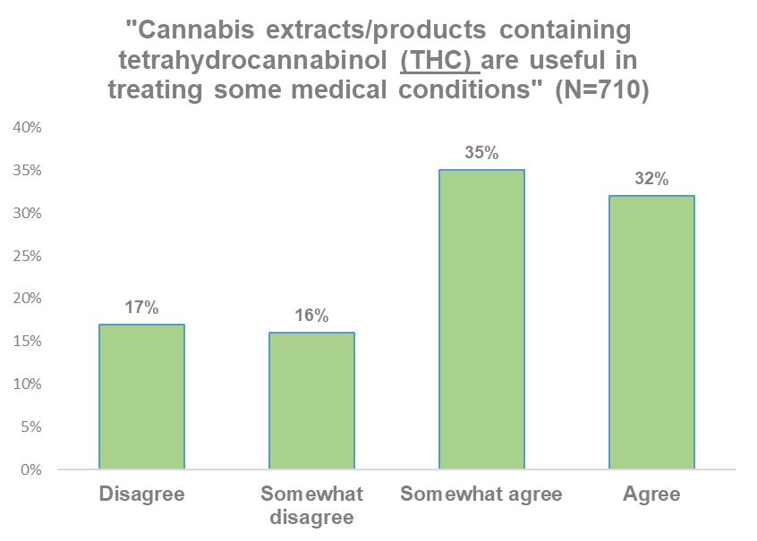
Results: Attitudes

Slide 15
Results: Attitudes

Slide 16
Results: Beliefs

Slide 17
Results: Knowledge

Slide 18
Results: Knowledge

Slide 19
Results: Knowledge

Slide 20
Results
Results:
Associations

Slide 21
Discussion
Gap between physician attitudes toward cannabis and self-perceived knowledge on cannabinoid pharmacology (esp CBD v THC)
Qualifying conditions: End of Life and Palliative Care
CEUs and clinician training on MC
Cannabis-related knowledge and role of provider institutions

Slide 22
Qualifying Conditions in Other States
Pain (Chronic, Post Surgical)
Arthritis (Rheumatoid, Osteoarthritis)
Cancer (Emaciation, Nausea)
Fibromyalgia
Neuromuscular Disorders (Spaticity, tremors)
PTSD
Palliation and Hospice

Slide 23
Continuing Medical Education in Other States

Slide 24

Provider Institutions
Cannabis and Cannabinoids (PDQ®): Integrative, alternative, and complementary therapies - Health Professional Information [NCI]

Slide 25
Next Steps
Surveillance of program participants
Supply side conditions
Program implementation and Evaluation

Slide 26
THANK YOU

