Slide 1
Cannabis Use and Risk of Falling in Older Adults
R21 AG0643308-01 National Institute on Aging
Thorsten Rudroff, PhD
University of Iowa

Slide 2
DISCLOSURE(S)
I have no commercial relationships to disclose.

Slide 3
Cannabis Use and Risk of Falling in Older Adults
Introduction
Cannabis is the third most prevalent substance consumed by adults aged 50 years and older _{Blazer et al.2009}
Dramatic increase in older adults who use cannabis in recent years _{Han et al. 2018}

Slide 4
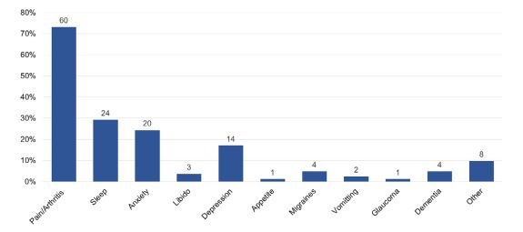
Cannabis Use and Risk of Falling in Older Adults
Introduction
Yang et al. 2021, The American Geriatrics Society

Slide 5
Cannabis Use and Risk of Falling in Older Adults
Introduction
Medical Marijuana / Cannabis
Complex mixture of more than 400 compounds derived from the Cannabis sativa plant.
60 different compounds described with activity on the cannabinergic system
Most abundant cannabinoids are
THC - Delta-9 tetrahydrocannabinol
CBD - Cannabidiol
CBN – Cannabinol
CBG - Cannabigerol

Slide 6
Cannabis Use and Risk of Falling in Older Adults
Introduction
Medical Marijuana / Cannabis
In combination, THC and CBD probably account for most of cannabis’ known effects.
They have very different physiological and pharmacological properties.

Slide 7
Cannabis Use and Risk of Falling in Older Adults
Introduction
THC - Delta-9 tetrahydrocannabinol
Adverse acute effects:
Anxiety, paranoia, impaired psychomotor performance and cognitive dysfunction Broyd et al., 2016; Curran et al., 2016
Adverse chronic effects:
Associated with increased risk of dependence, psychosis and cognitive impairment Broyd et al., 2016; Curran et al., 2016; Marconi et al.,2016
However, two large meta-analyses suggest that the adverse effects of chronic cannabis use on cognition may improve following abstinence (Schreiner & Dunn, 2012; Scott et al., 2018).

Slide 8
Cannabis Use and Risk of Falling in Older Adults
Introduction
CBD - Cannabidiol
Adverse effects:
CBD is not risk free, as it has both drug interaction and adverse event potential.
Somnolence and fatigue coupled with gastrointestinal disturbances are not uncommon, and rarer but serious events such as elevated liver function tests has been observed.
Because CBD is an effective anticonvulsant therapy, the FDA is concerned that it might similarly cause suicidal ideation White et al. 2019

Slide 9
Increased Likelihood of Falling in Older Cannabis Users vs. Non-Users
Falls and cognitive impairment are a “well-known couple” _{Montero-Odasso et al. 2012} older adults with moderate to severe cognitive impairment have a higher fall risk, with an annual incidence of around 60–80%, which is twice the rate of cognitively normal older adults _{Tinetti et al. 1988}
The physiological effects of chronic cannabis use may further increase fall risk.
Purpose
To investigate the fall risk, cognitive function, and motor function of older individuals (> 50 years) who use cannabis for medical purposes.
Workman et al. 2021, Brain Sciences
Notes:
Typical aging is characterized by physiological changes that make older adults vulnerable
to impaired function, chronic disease, and geriatric conditions such as falls and cognitive impairment _{Cigolle et al. 2007}

Slide 10
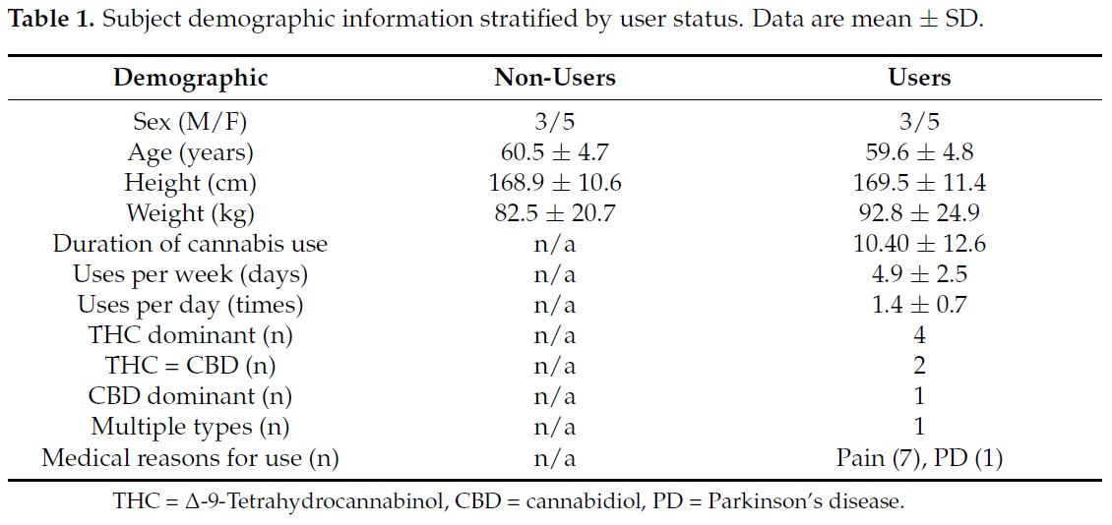
Increased Likelihood of Falling in Older Cannabis Users vs. Non-Users

Slide 11
Increased Likelihood of Falling in Older Cannabis Users vs. Non-Users
Berg Balance Scale (BBS-14)
Activities Balance Confidence (ABC-1) scale
9-Hole Peg Test (9-HPT)
Deary–Liewald reaction time (RT) tasks (simple and choice RT)
Flanker Inhibitory Control and Attention Test
Static posturography
30-m walk test
Lajoie and Gallagher (2004)

Slide 12
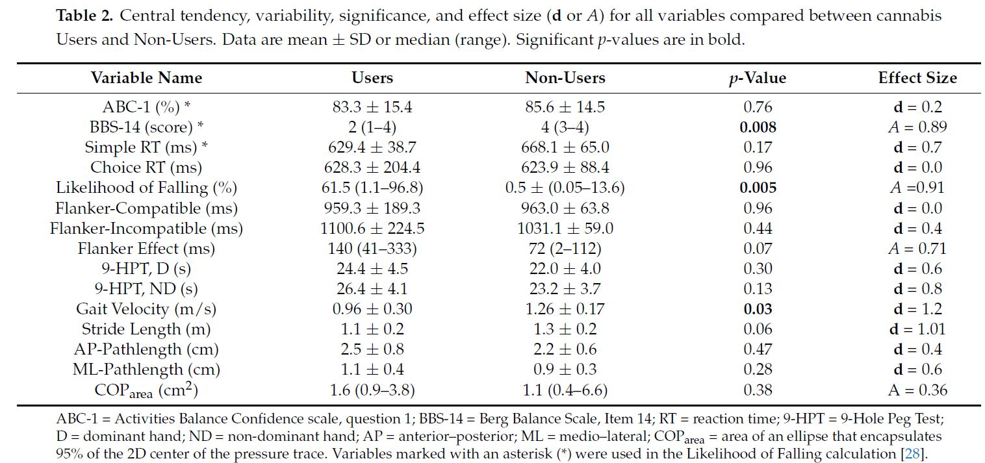
Increased Likelihood of Falling in Older Cannabis Users vs. Non-Users

Slide 13
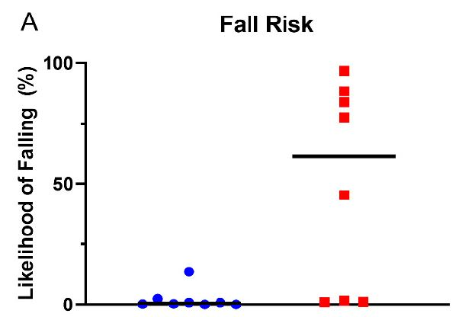
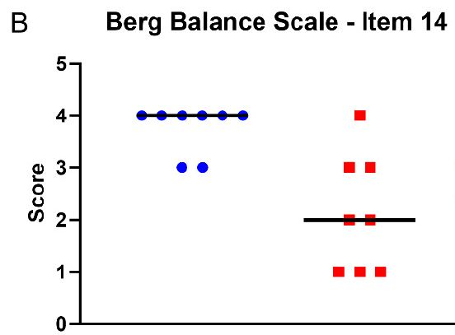
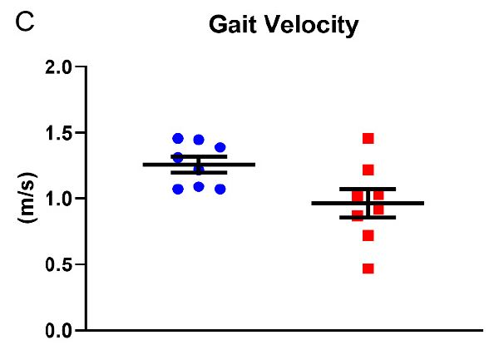
Increased Likelihood of Falling in Older Cannabis Users vs. Non-Users

Slide 14
Increased Likelihood of Falling in Older Cannabis Users vs. Non-Users
Users had a higher fall risk than Non-Users and exhibited slower gait velocity during the 30-m walk test than Non-Users.
Physiological mechanisms:
CB1 receptor activation might influence descending signals from the motor cortex, via the modulation of neurotransmitter release in basal ganglia and motor cortex neurons.
This might stem from the activation of CB1 receptors in movement related brain regions by this intoxicating cannabis compound.
Notes:
Additionally, it is known that cannabis intoxication results in acute motor deficits, including changes in balance. Indeed, an acute THC concentration dependent disturbance in balance has been observed, with increasing levels resulting in more body sway.

Slide 15
Increased Likelihood of Falling in Older Cannabis Users vs. Non-Users
No significant differences in cognitive function were found.
All cannabis products used by the subjects included at least some amount of CBD, which has anti-inflammatory properties and may diminish the negative cognitive influences of low-grade inflammation seen in aging.

Slide 16
Disparity between Perceptual Fall Risk and Physiological Fall Risk in Older Cannabis Users
Purpose
To report the findings of a follow-up analysis of this dataset to investigate possible discrepancies between perceptual and physiological fall risk in older cannabis users.
Hypothesis: Older cannabis users would exhibit a poor perception of fall risk and have a higher physiological fall risk than non-users, indicating a disparity between the two concepts in the users group.
Workman et al. 2022, Environ. Res. Public Health

Slide 17
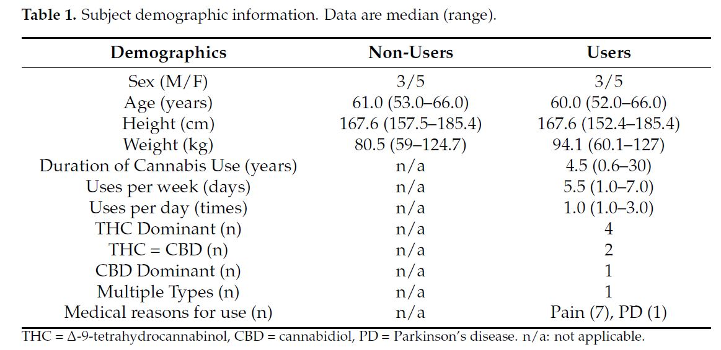
Disparity between Perceptual Fall Risk and Physiological Fall Risk in Older Cannabis Users

Slide 18
Disparity between Perceptual Fall Risk and Physiological Fall Risk in Older Cannabis Users
Activities Balance Confidence scale (ABC-1; perceived fall risk)
Item 14 of the Berg Balance Scale (BBS-14; physiological fall risk) as part of the fall risk model developed by Lajoie and Gallagher (2004)
Static posturography (physiological fall risk) was performed on a balance board (Balance Tracking Systems)

Slide 19
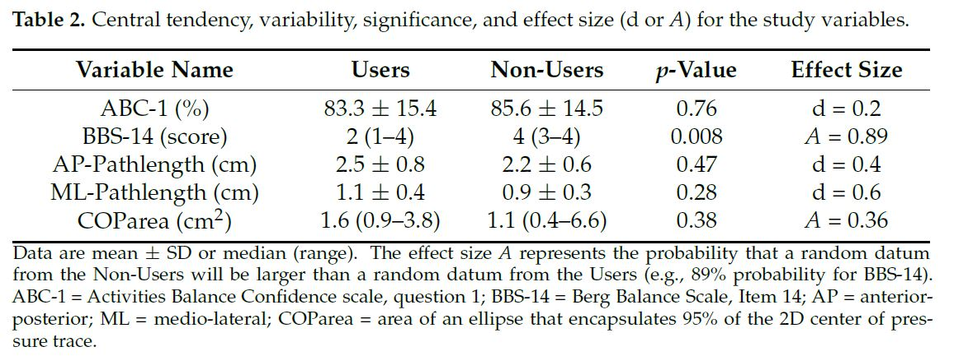
Disparity between Perceptual Fall Risk and Physiological Fall Risk in Older Cannabis Users

Slide 20
Disparity between Perceptual Fall Risk and Physiological Fall Risk in Older Cannabis Users
Perceived Fall Risk
Physiological Fall Risk

Slide 21
Disparity between Perceptual Fall Risk and Physiological Fall Risk in Older Cannabis Users
No significant correlations (Spearman’s rho; more conservative statistic, considering the small sample size) between ABC-1 and the physiological fall risk outcomes (BBS-14, AP-Pathlength, ML-Pathlength, and COParea).

Slide 22
Disparity between Perceptual Fall Risk and Physiological Fall Risk in Older Cannabis Users
Perceived fall risk and objective/physiological fall risk (e.g., performance on a balance task) are incongruent in some older adults.
Aligning fall risk perception with physiological fall risk is important for fall prevention and rehabilitation.
Additional measures of perceptual (e.g., cognition, fear of falling, depression, anxiety) and physiological (e.g., more challenging static and dynamic balance conditions) fall risks would be beneficial for future studies.

Slide 23
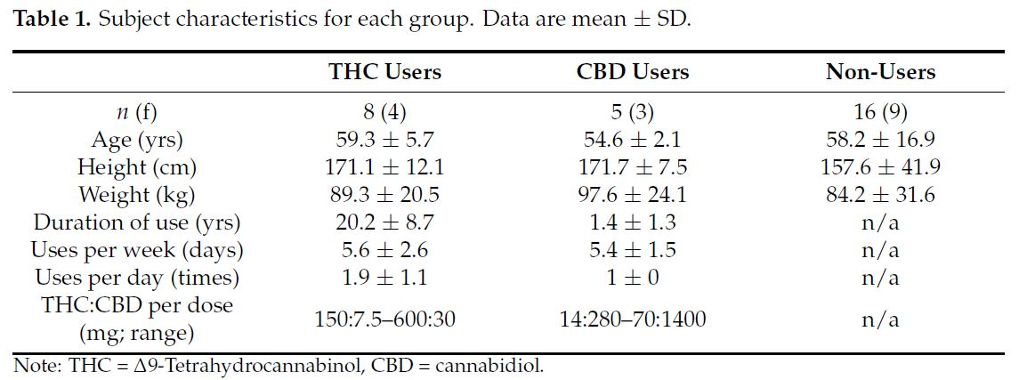
Differences in Inhibitory Control and Resting Brain Metabolism between Older Chronic Users of THC or CBD
Rudroff et al. 2022, Brain Sciences

Slide 24
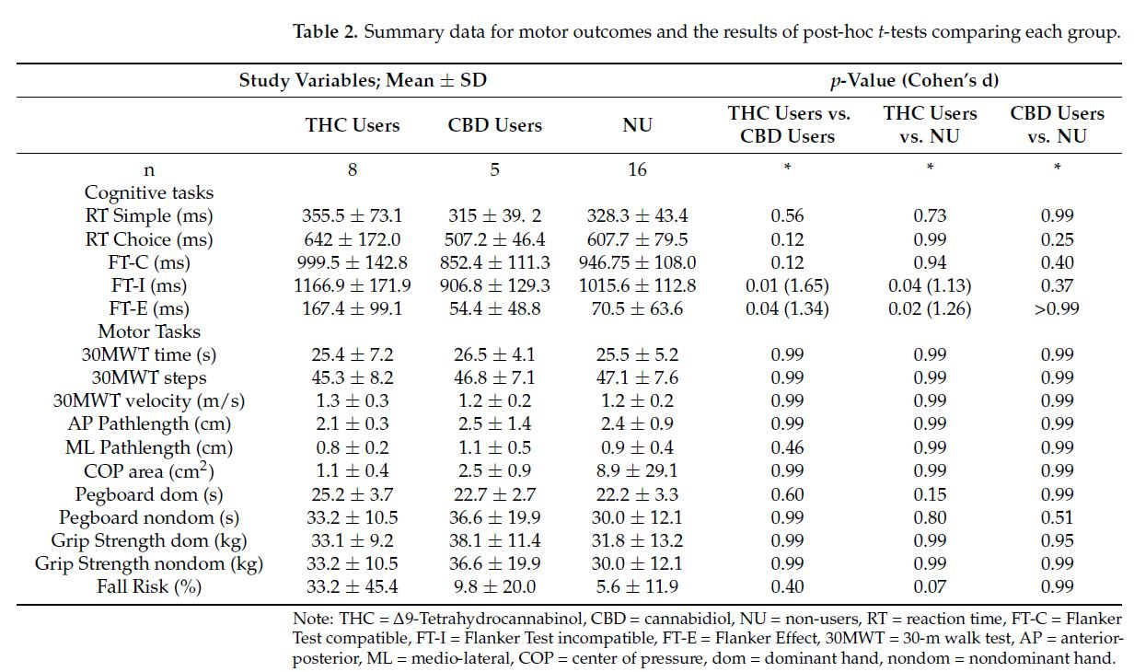
Differences in Inhibitory Control and Resting Brain Metabolism between Older Chronic Users of THC or CBD

Slide 25
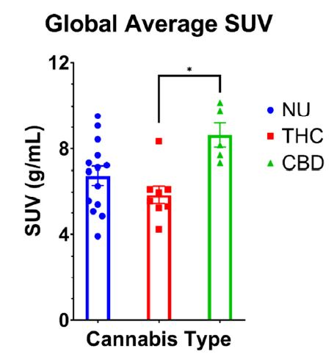
Differences in Inhibitory Control and Resting Brain Metabolism between Older Chronic Users of THC or CBD

Slide 26
Non-User
Chronic-THC User

Slide 27
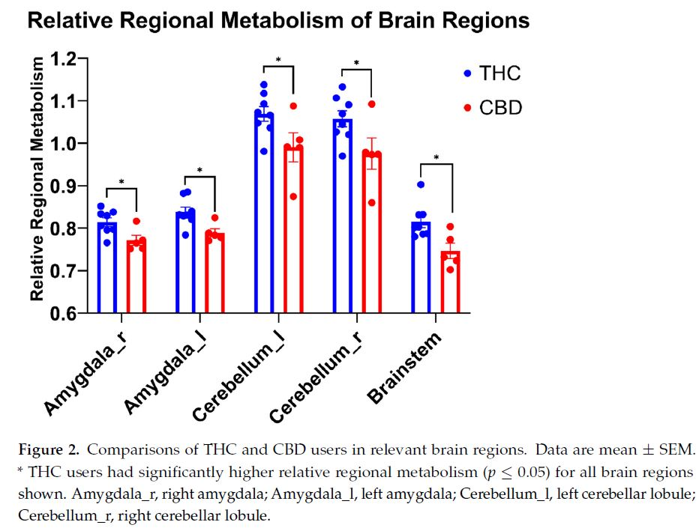
Differences in Inhibitory Control and Resting Brain Metabolism between Older Chronic Users of THC or CBD

Slide 28
Summary / Discussion
Older adults who chronically use cannabis have increased fall risk and slower gait velocity.
Perceived fall risk and objective/physiological fall risk (e.g., performance on a balance task) are incongruent in some older adults.
Aligning fall risk perception with physiological fall risk is important for fall prevention and rehabilitation.

Slide 29
Summary / Discussion
THC and CBD may have unique effect profiles, underscoring the importance of delineating between types of cannabis use in future research.
THC content might be responsible, at least in part, for the decreased performance on the Flanker
Test observed in our study.
Furthermore, these effects might be accompanied by lower global metabolism and greater relative metabolism in the amygdala, cerebellum, and brainstem of THC users compared to CBD users.

Slide 30
THANK YOU!

