Slide 1
Medical Marijuana Laws and Out of Pocket Expenses at End of Life
Divya Bhagianadh, PhD, Rutgers School of Social Work
Kanika Arora, PhD, College of Public Health, University of Iowa

Slide 2
Background
High out-of-pocket (OOP) expenses during EOL (Kelley et al., 2010; Marshall et al., 2010)
43% decedents exhaust their non-housing assets in the last five years of life (Kelley et al., 2010)
Spending on drugs – among the top 3 contributors in the last year of life (Marshall et al., 2010)
MML and reduction in prescription drug use among older adults, reduction in Medicare expenses on drugs (Wen & Hockenberry, 2018; Bradford & Bradford, 2017)
MML can influence OOP expenses at End of Life (EOL), especially that related to drugs and doctor visits

Slide 3
Mechanisms
Regulatory pathway
Increased OOP expenses on drugs at EOL
Increased OOP expenses on doctor visits at EOL
Discordant legal status (Federal/ state levels)
Non-coverage of medical cannabis & related expenses
Dependence on Out-of-network providers for certification
MML
Clinical efficacy & safety pathway
Mode of use (non-smoking is more expensive)
Multiple doc visits/visits to multiple doctors due to concerns about the use of medical marijuana

Slide 4
Data & sample
Geocoded state level restricted Health and Retirement Study (HRS) exit interviews (1995 to 2018)
RAND HRS detailed imputations file for EOL OOP expenditures
Sample restricted to
>=65 years at the time of death
No missing covariates (2,044 (15%) decedents excluded)
Final sample size: 11,289 decedents

Slide 5
Outcome variables
OOP expenses on drugs:
“On average, about how much did he/she pay out-of-pocket per month for the prescription medications … in the last two years?”
Multiplied by 24 in the RAND HRS imputations file to reflect cost over two years
OOP expenses on doctor visits:
“About how much did he/she pay out-of-pocket for doctor or clinic visits … in the last two years?”
Log transformed OOP expenses in 2018 dollars

Slide 6
Key independent variable & covariates
Key explanatory variable: Presence of MML
Treatment states: States with an effective MML by June 2018; Coded as “0” prior to MML implementation and “1” thereafter
Control states: States that did not pass an MML by June 2018; Coded as “0” through 1994-2018 (never implementers)
Individual decedent level covariates
Socio-demographics, functional limitations, comorbidities, duration alive from the last core interview
Time-varying state-level controls
State-level policies (recreational marijuana laws, prescription drug monitoring programs), health system- supply-side variables, variables indicating EOL intensity, state LTSS environment and economic environment

Slide 7
Empirical Strategy
Difference in Differences (OLS regression models)
${Log OOP expenses}_{ist}= β_{0}+β_{1}{MML}_{ist}+β_{2}X_{ist}+ β_{3} Z_{st}+ ∂_{s}+γ_{t}+ ε_{st}$
Event study model
Other robustness checks
Models with and without time varying state level controls
Callaway & Sant’Anna ‘CSDID’ estimates
Subgroup analyses: number of qualifying conditions, cause of death, race, gender, place of residence

Slide 8
Results
 | Log of OOP expenses
 | Drugs |  |  | Doctor visits
Panel 1: No state level covariates
MML | 0.33** | 0.33** | 0.33** | 0.31*
 | (0.11) | (0.11) | (0.11) | (0.14)
ªp-value for joint F-test for pre-trends | 0.81 | 0.81 | 0.81 | 0.09
N | 11,289 | 11,289 | 11,289 | 11,289
Panel 2: With state level covariates
MML | 0.34** | 0.34** |  | 0.42**
 | (0.12) | (0.12) |  | (0.15)
ªp-value for joint F-test for pre-trends | 0.72 | 0.72 |  | 0.04
N | 11,289 | 11,289 |  | 11,289
CSDID estimates |  | 0.69* |  | 0.73*
OOP expenses in tt state in pre tt period (2018 $) | 1,991.93 | 1,991.93 |  | 887.12
Clustered std. errors at the state level in parentheses; *p<0.05, **p<0.01, ***p<0.001
Both models control for individual level covariates. Panel 2 models also include time varying state level control variables. MML- Medical Marijuana Legalization
ªp-value for F-test for null hypothesis: the difference in collective pre-period trends between the treatment and control group is zero.
Notes:
this translates to an increase of nearly USD 650 and 275 respectively in the last two years before death for decedents in the treatment states.

Slide 9
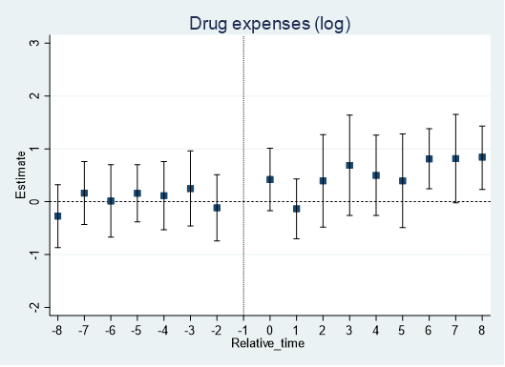
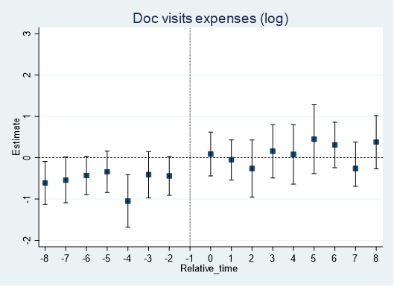
Event study estimates
Event study models with all covariates

Slide 10
Heterogeneity by program characteristics
 |  | Log of OOP expenses
 |  | Drugs | Doc visits
Panel 1: Early adopting states
MML |  | 0.72*** | 0.88***
 |  | (0.14) | (0.24)
N |  | 6,614 | 6,614
Panel 2: Late adopting states
MML |  | 0.17 | 0.11
 |  | (0.29) | (0.21)
N |  | 9,039 | 9,039
>99% registered users are in these states
Clustered std. errors at the state level in parentheses; *p<0.05, **p<0.01, ***p<0.001
All models control for all covariates. MML- Medical Marijuana Legalization ªp-value for F-test for null hypothesis for testing pre-period trends was not significant for all models

Slide 11
Moderating effects: OOP drug expenses
 | Log OOP expenses on drugs
Panel 1: Race
 | Whites | Non- Whites
MML | 0.42** (0.16) | -0.56⁺ (0.31)
N | 9,309 | 1,980
Panel 2: Place of residence
 | Metro | Non- metro
MML | 0.43** (0.12) | 0.35 (0.21)
N | 5,292 | 5,997
Panel 3: No. of qualifying conditions
 | Single qualifying condition | 2-5 qualifying conditions
MML | 0.44 (0.26) | 0.38* (0.18)
N | 3,470 | 6,174
Clustered std. errors at the state level in parentheses; *p<0.05, **p<0.01, ***p<0.001
All models control for all covariates. MML- Medical Marijuana Legalization
p-value for F-test for null hypothesis for testing pre-period trends was not significant for all models

Slide 12
Key takeaways
MML passage leads to an increase in OOP expenses for drugs and doctor visits at EOL
MML associated with an increase of nearly USD 650 and 275 for drugs and doctor visits respectively in the last two years before death as OOP expenses for decedents in the treatment states.
Evidence of cost shifting to patients
Cost savings for Medicare & Medicaid (Bradford & Bradford, 2017, 2018)
Differential impact reflects differential access to quality assured products
Medical cannabis costs should be part of healthcare cost discussions
85% medical cannabis users → conditions with substantial evidence of therapeutic effectiveness (Boehnke et al., 2019)

